Slide 1
Artificial Neural Networks Dr. Farhan hassan khan
MACHINE LEARNING

Slide 2
Today’s Topics
Biological Neurons: Inspiration
Artificial Neuron: Perceptron

Slide 3



Inspiration: Animal’s Computing Machinery
Neuron
- basic unit in the nervous system for receiving, processing, and transmitting information; e.g., messages such as…
“hot”
“loud”
“spicy”

Slide 4
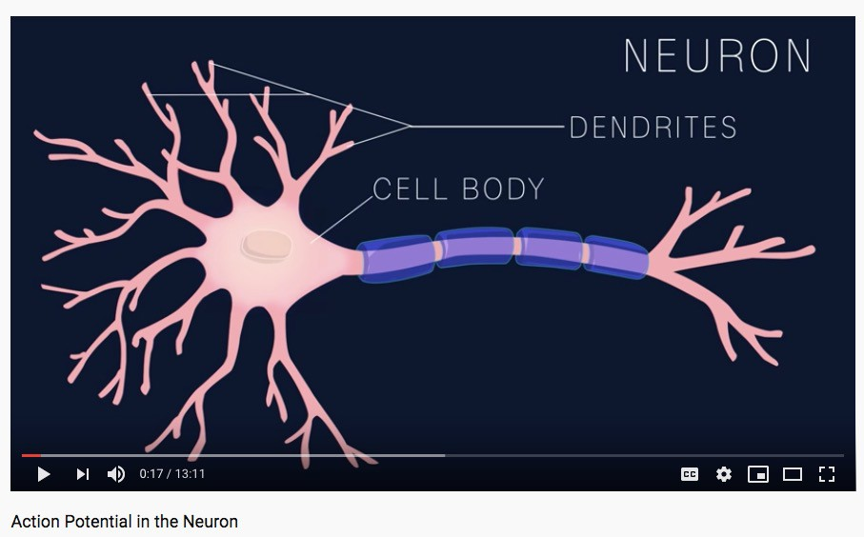
Inspiration: Animal’s Computing Machinery
Demo (0-1:14): https://www.youtube.com/watch?v=oa6rvUJlg7o

Slide 5
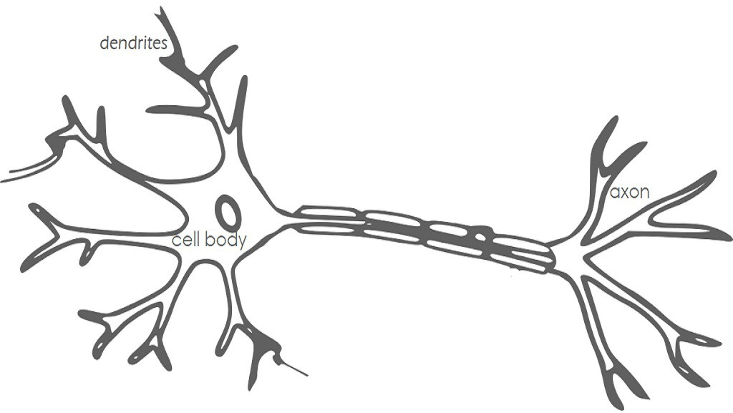
Inspiration: Neuron “Firing”
When the input signals exceed a certain threshold within a short period of time, a neuron “fires”
Neuron “firing” (outputs signal) is an “all-or-none” process

Slide 6
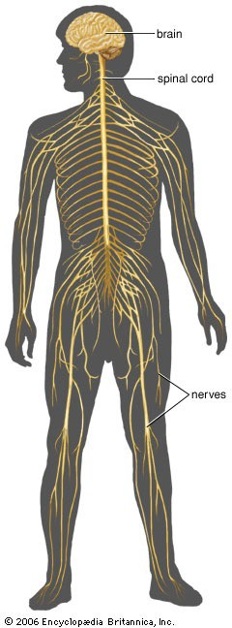
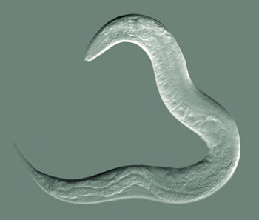
Inspiration: Animal’s Computing Machinery
Nematode worm:
302 neurons
Human:
~100,000,000,000 neurons

Slide 7
Today’s Topics
Biological Neurons: Inspiration
Artificial Neuron: Perceptron

Slide 8
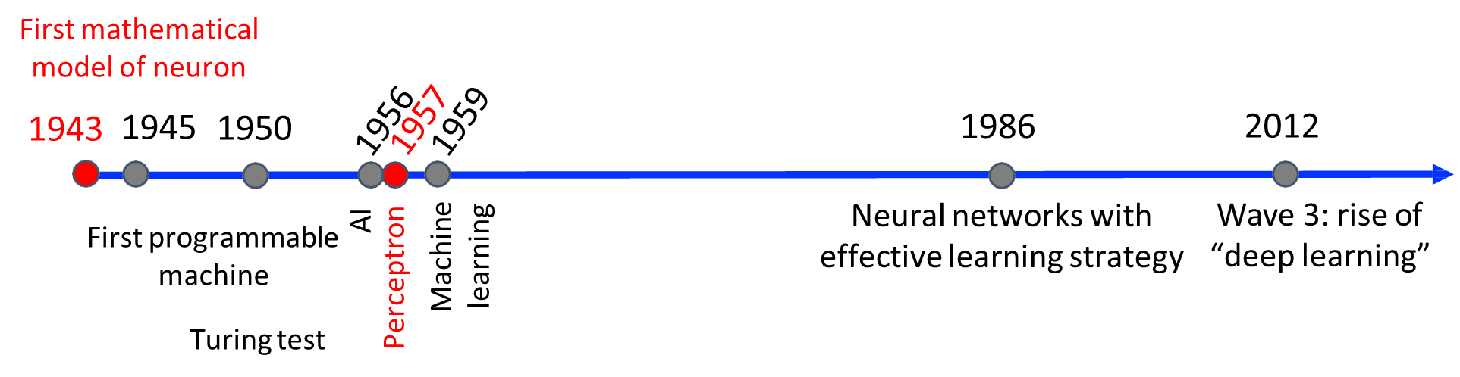
Historical Context: Artificial Neurons
Recall: modern deep learning algorithms rely on techniques developed over the past 65 years.

Slide 9
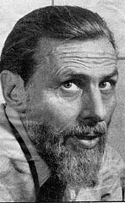
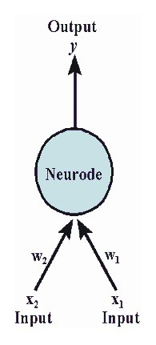
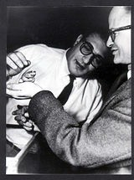
Artificial Neuron: McCulloch-Pitts Neuron
Note: NO learning involved
weights (W) and threshold (T) values are fixed
inputs and weights can be 0 or 1
fires when combined input exceeds threshold
Warren McCulloch Neurophysiologist
Walter Pitts Mathematician

Slide 10
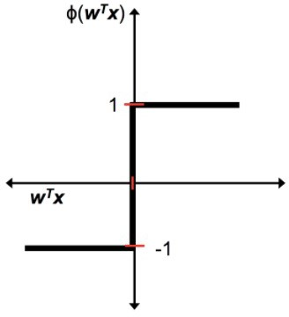
Artificial Neuron: McCulloch-Pitts Neuron
1
Mathematical definition: z =
“fire” or “do not fire”
mimics human brain
-1 otherwise
z =

Slide 11
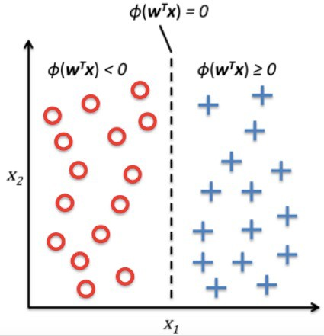
Artificial Neuron: McCulloch-Pitts Neuron
1
Mathematical definition: z =
-1 otherwise

Slide 12
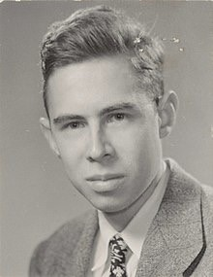
Perceptron: Innovator and Vision
“[The perceptron is] the embryo of an electronic computer that [the Navy] expects will be able to walk, talk, see, write, reproduce itself and be conscious of its existence…. [It] is expected to be finished in about a year at a cost of $100,000.”
Frank Rosenblatt Psychologist

Slide 13
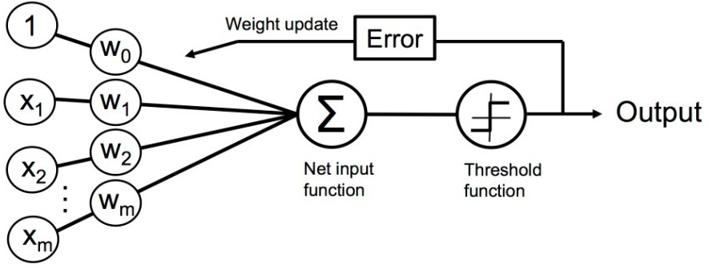
Perceptron: Model (Linear Threshold Unit)
Note:
weights (W) are learned
- inputs and weights can be any value
fires when combined input exceeds threshold
Frank Rosenblatt, The perceptron, a perceiving and recognizing automaton Project Para. Cornell Aeronautical Laboratory, 1957

Slide 14




Perceptron: Model (Linear Threshold Unit)
Fires when a function exceeds threshold:
Rewriting model:
Where:
Bias
1

Slide 15
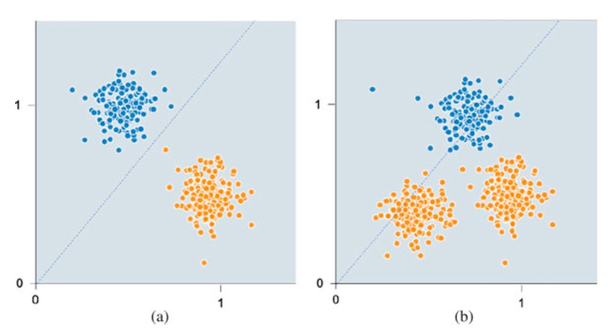
Perceptron: Model (Linear Threshold Unit)
Motivation for bias: without it, model must go through origin
Error
Bias
1

Slide 16
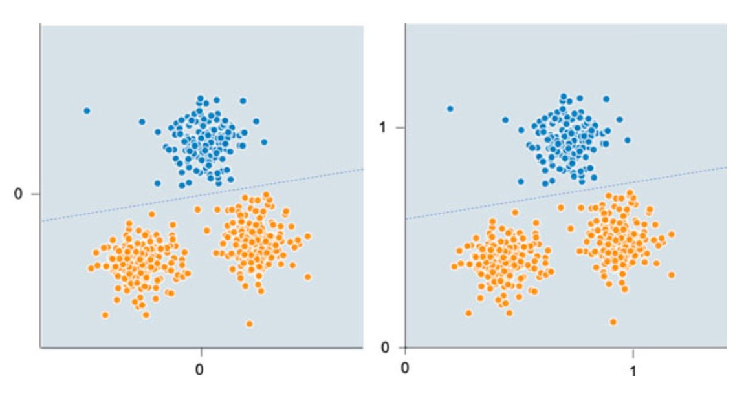
Perceptron: Model (Linear Threshold Unit)
Motivation for bias: with it, model does not have to go through origin
Bias
1

Slide 17

Perceptron: Model (Linear Threshold Unit)

Slide 18
Perceptron: Model (Linear Threshold Unit)
“Input signals”
“Output signal”
Artificial Neuron:
Biological Neuron:

Slide 19
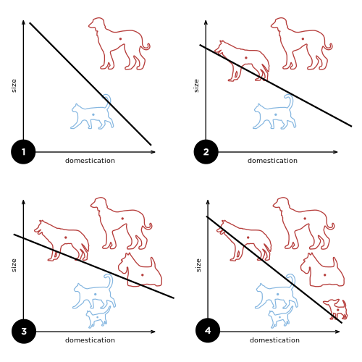
Perceptron: Learning Algorithm
Iteratively update linear boundary with observation of each additional example:

Slide 20
Perceptron: Learning Algorithm
Iteratively update linear boundary with observation of each additional example:

Slide 21



Perceptron: Learning Algorithm
Initialize weights to 0 or small random numbers
For each training sample:
Compute output value:
Update weights with the following definition:
Learning Rate
True Class Label
Predicted Class Label

Slide 22
Perceptron: Learning Algorithm - What Happens to Weights When It Predicts Correct Class Label?
Initialize weights to 0 or small random numbers
For each training sample:
Compute output value:
Update weights with the following definition:
equals 0, so no weights update
Learning Rate
True Class Label
Predicted Class Label

Slide 23
Perceptron: Learning Algorithm - What Happens to Weights When It Predicts Wrong Class Label?
Initialize weights to 0 or small random numbers
For each training sample:
Compute output value:
Update weights with the following definition:
equals positive or negative value, so weights change
Learning Rate
True Class Label
Predicted Class Label

Slide 24


Perceptron: Learning Algorithm (e.g., 2D dataset)
Initialize weights to 0 or small random numbers
For each training sample:
Compute output value:
Update weights with the following definition:
0
All weights updated simultaneously
1
1
2
2

Slide 25
Perceptron: Learning Algorithm

Slide 26
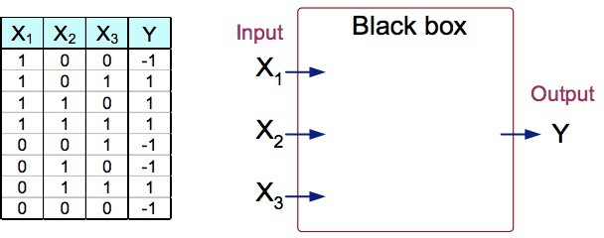
Perceptron: Learning Algorithm Example
True Model: Y is 1 if at least two of the three inputs are equal to 1.
?

Slide 27
Perceptron: Learning Algorithm Example
True Model: Y is 1 if at least two of the three inputs are equal to 1.
?

Slide 28
Perceptron: Learning Algorithm Example
True Model: Y is 1 if at least two of the three inputs are equal to 1.
?

Slide 29
Perceptron: Learning Algorithm Example
True Model: Y is 1 if at least two of the three inputs are equal to 1.

Slide 30

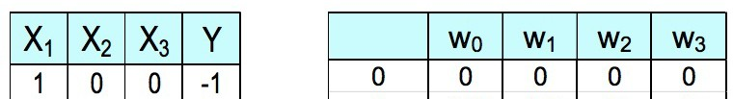
Perceptron: Learning Algorithm Example
- First Sample
Compute output value:
1 if
-1 otherwise
;
=
Predicted
?

Slide 31
Perceptron: Learning Algorithm Example
- First Sample
Compute output value:
1 if
-1 otherwise
;
=
Predicted
1

Slide 32



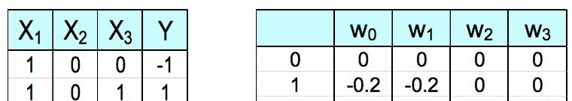
Perceptron: Learning Algorithm Example
- First Sample
Update weights: learning rate = 0.1
Predicted 1
0
1 | 1
2 | 2
3 | 3
?
?
?
?

Slide 33
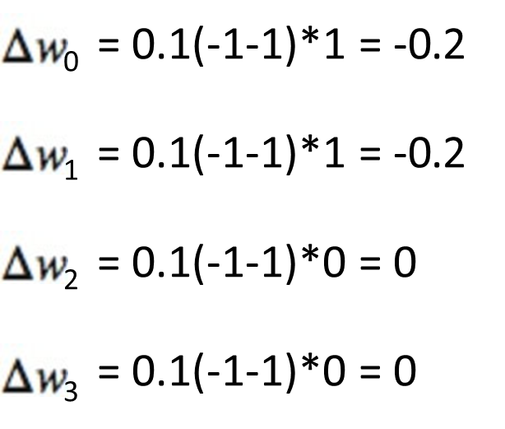
Perceptron: Learning Algorithm Example
- First Sample
Update weights: learning rate = 0.1
Predicted 1
?
?
?
?

Slide 34
Perceptron: Learning Algorithm Example
- Second Sample
Compute output value:
1 if
-1 otherwise
;
=
Predicted 1
?

Slide 35
Perceptron: Learning Algorithm Example
- Second Sample
Compute output value:
1 if
-1 otherwise
;
=
Predicted 1
-1

Slide 36
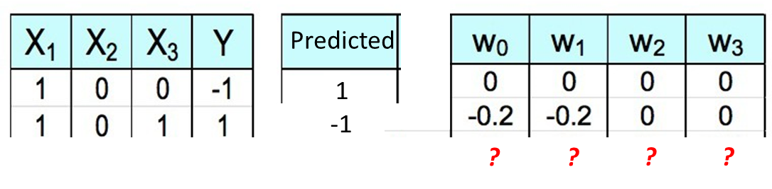
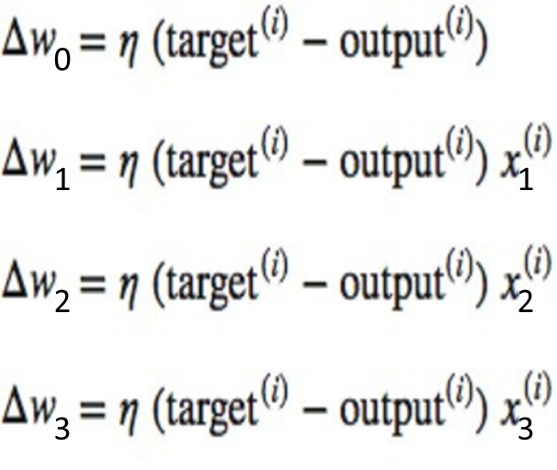
Perceptron: Learning Algorithm Example - Second Sample
Update weights: learning rate = 0.1

Slide 37
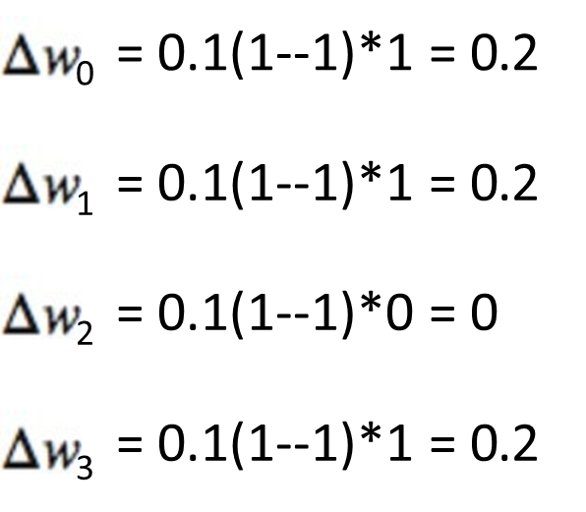
Perceptron: Learning Algorithm Example - Second Sample
Update weights: learning rate = 0.1

Slide 38
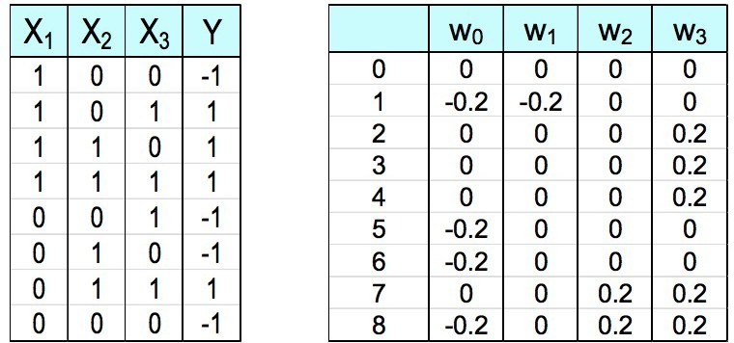
Perceptron: Learning Algorithm Example - One Epoch (All Examples)
learning rate = 0.1

Slide 39
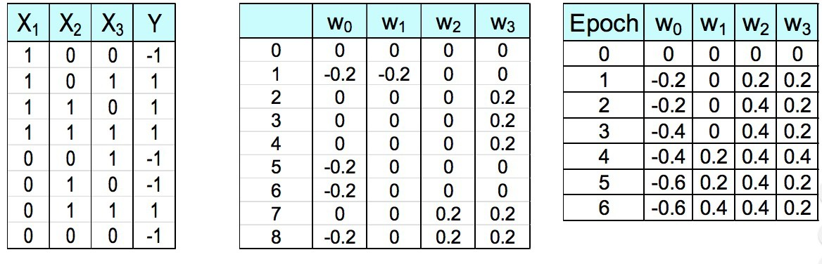
Perceptron: Learning Algorithm Example - Six Epoch (All Examples)
learning rate = 0.1

Slide 40
Perceptron: Learning Algorithm Example - Six Epoch (All Examples)
learning rate = 0.1

Slide 41
Perceptron: Learning Algorithm Choices
Learning rate
Number of epochs (passes over the dataset)

Slide 42


